Slide 1
Visualisation for policy
Information visualisation in humanities
Interenational conference, Toruń, 23-24 March 2017
Jan Kozłowski

Slide 2
E-governance
„The explosive growth in data, computational power, and social media creates new opportunities for innovating governance and policy-making. ICT developments affect all parts of the policy-making cycle and result in drastic changes in the way policies are developed. To take advantage of these developments in the digital world, new approaches, concepts, instruments, and methods are needed, which are able to deal with societal complexity and uncertainty.”
Marijn Janssen and Maria A.Wimmer, Introduction to Policy-Making in the Digital Age

Slide 3
Policy cycle

Slide 4
Visual Decision Support for Policy Making

Slide 5
Information visualization specialists:
overview,
zoom,
filter,
prepare details-on-demand,
relate,
show trends, and
extract
Benjamin B. Bederson and Ben Shneiderman, The Craft of Information Visualization (2013)

Slide 6
Visualisation represents models by:
graphs, trees, and cones;
proximity and connectivity (such as semantic distance and word search, multi-dimensional scaling, and network analysis);
clustering and classification (e.g., dividing data into sub-sets and taxonomies, cluster-seeds);
creating networks (scale, small or large, topological, nodes, etc.).
creating virtual structures (e.g., WordNet, Wordle, etc.);
use of glyphs (e.g., using symbols on charts to convey additional information);
Chen Chaomei, Information Visualization: Beyond the Horizon, 2nd Ed., London: Springer-Verlag, 2006

Slide 7
GAP
(problem definition)
Disruption
Barrier
Disproportion
Trap
Bottleneck

Slide 8
Gap
Distance
Difference
Incompatibility
Between state A and state B
On the timeline
On the axis of the place
You have to eliminate or reduce it.
Allowing it to persist or grow causes harmful effects.

Slide 9
Gap
Fight the gap can be directly or indirectly.
Directly - through intervention attacking the problem.
Indirectly - through intervention to activate market forces and / or social forces.
You have to measure and show it to citizens and policy-makers. How to do it?

Slide 10
Gap at a glance (Retreat of the shoreline)
http://www.visualisingdata.com/index.php/2014/12/10-significant-visualisation-developments-july-december-2014/

Slide 11
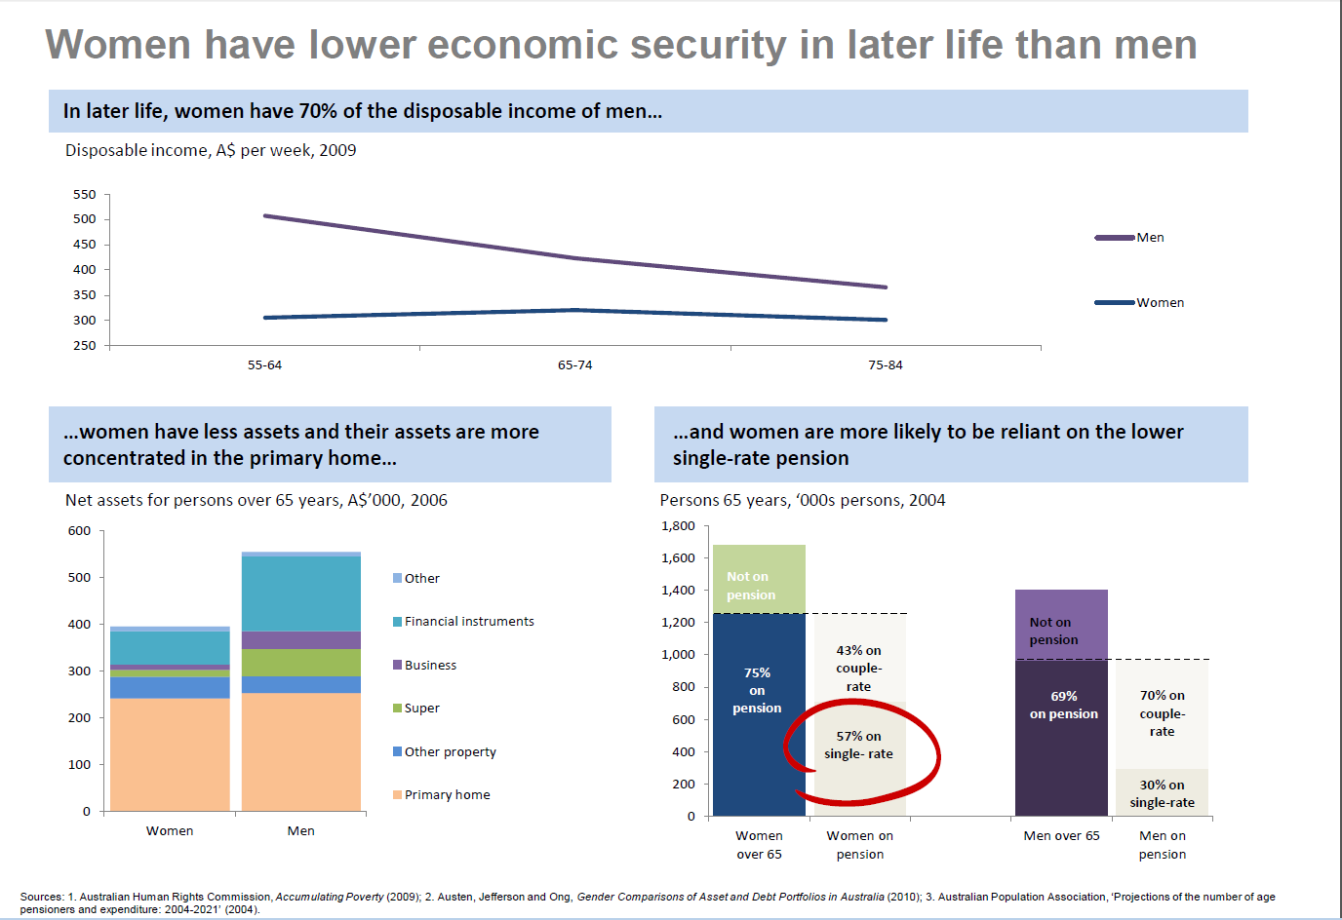
Gap presented in narrative form

Slide 15
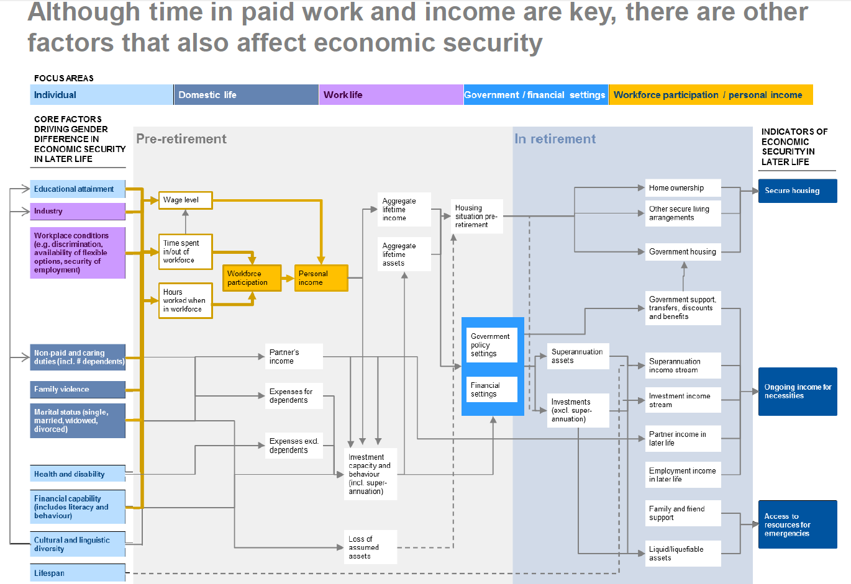

Slide 16
What should the government do to close the gap?
What is the gap?
Does the gap change over time?
What are the sources of the gap?
What effect did the earlier policies give?
What was tried before?
What are the options for the government?
What are the main causes of the gap?
What other factors cause or mitigate the gap?
What are the couplings and the dynamics of the gap?
What new instruments can be introduced?
What opinions are flowing from NGOs, OECD, consultations?
Goals, tasks, indicators, scope, target group
Costs and benefits
Expected results and impacts

Slide 17
Transforming data into knowledge
Analysis supporting decision-making
Representations of knowledge and information (data aggregates, problem synthesis, visualization))
Data (database)

Slide 18
Some other policy visualisations

Slide 19
NESTA: Creative and High Tech Economy in Britain

Slide 20
Five years after the Great Recession ended, the economy finally regained lost nine million jobs. But not all industries regained it equally.
Colors: from take-off and growth to the recession and fall. Horizontal line: pay level (from low to high)
Jeremy Ashkenas And Alicia Parlapiano , How the Recession Reshaped the Economy, in 255 Charts, JUNE 6, 2014

Slide 21
The diagram shows how many people live in cities close to each other (according to the number of people living each square kilometer 100 x 100 km of urban area) http://lsecities.net/media/objects/articles/urban-age-cities-compared/en-gb/

Slide 22
Population represented as peaks and valleys
http://www.popsci.com/best-data-visualizations?image=8

Slide 23
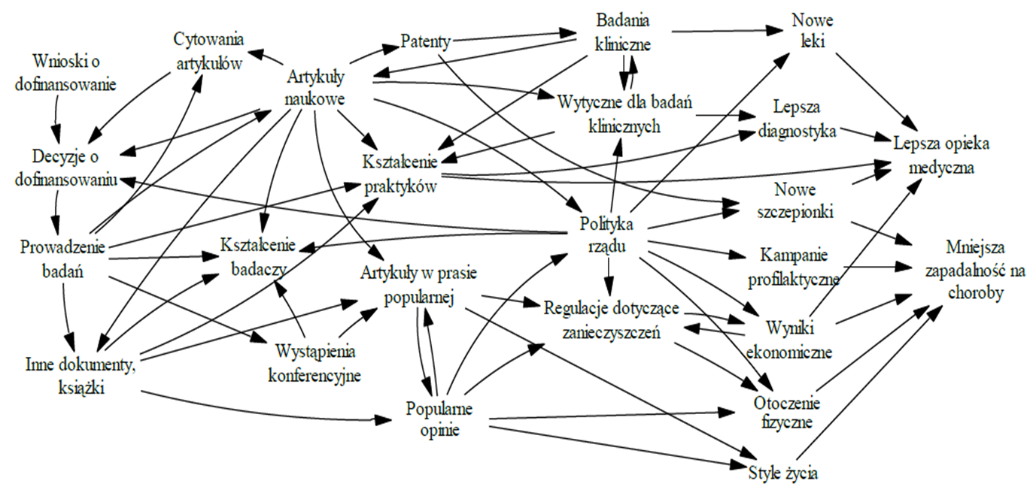
A network of relationships between medical research and public health

Slide 24
Cost/effectiveness analysis for education intervention

Slide 25
Policy visualisation diverse initiatives: networks, books, seminars, portals…

Slide 26
UK: Alliance for Useful Evidence

Slide 27
UK: What Works Network

Slide 28
Flandria: Steunpunten Beleidsrelevant Onderzoek

Slide 29
Australia: Policy Visualisation Network

Slide 30
Germany, China, Singapore: Cyclical workshops

Slide 31
Books

Slide 32
UN: Intergovernmental Platform on Biodiversity & Ecosystem Services

Slide 33
EU: integration of policy evidence producers

Slide 34
EU project (2013-2016)

Slide 35
Sources
Veslava Osińska, Grzegorz Osiński, Polityka finansowania nauki – z wykorzystaniem metod wizualizacji
Evan Hill, Australian Public Service (APS) Policy Visualisation Network
Visualising policy
Krzysztof Klincewicz i inni, Obserwatorium badań naukowych i rozwoju technologii 2011
Places & Spaces: Mapping Science
PolicyViz
Katy Börner, David E. Polley, Visual Insights: A Practical Guide to Making Sense of Data, 2014, MIT.

Slide 36
Dziękuję za uwagę!

